Slide 1
Memory Forensics Using Volatility 3 — Phase 3 Analysis
Investigating Pre-Attack, During-Attack, and Post-Attack Memory States
Group Members: Devarshi Mahadevwala

Slide 2
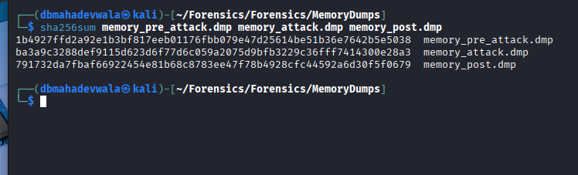
SHA-256 Hash Validation of All Memory Dumps
All three dumps were hashed using SHA-256 to verify integrity and uniqueness.
Each dump produced a different hash, confirming each memory image represents a distinct system state.
Hashing is also critical for evidence preservation and chain-of-custody in forensic investigations.
Demonstrates no tampering occurred between acquisition and analysis.

Slide 3
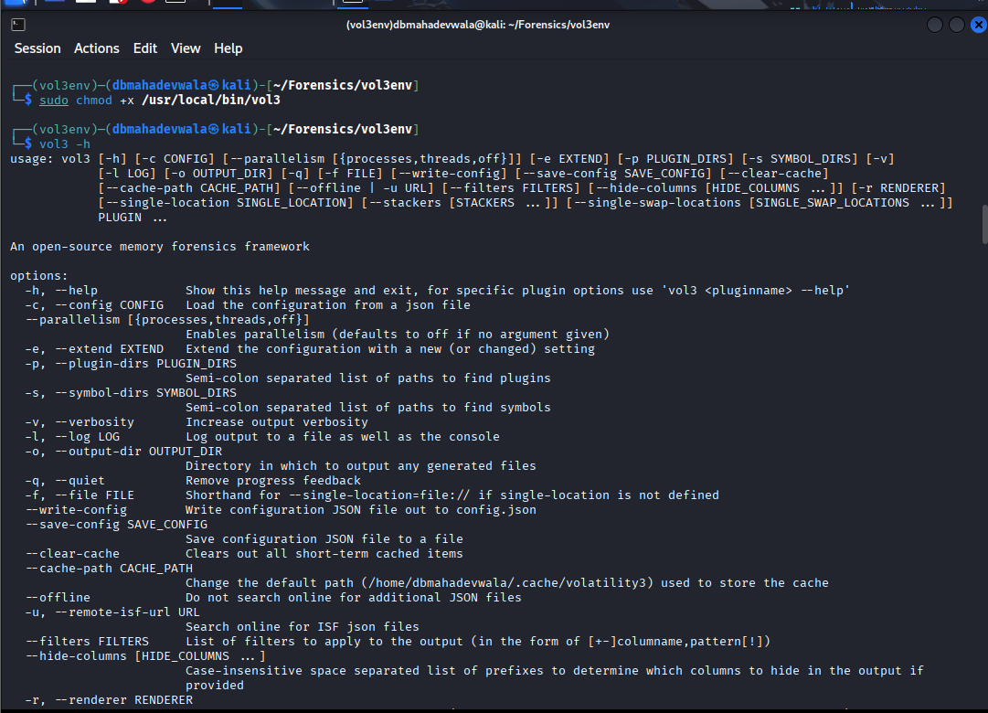
Volatility 3 Environment Operational
Volatility 3 virtual environment activated successfully, ensuring accurate plugin execution.
vol3 -h output confirms plugin availability across process, handle, DLL, and network layers.
This environment serves as the core analysis engine for all memory artifacts examined

Slide 4
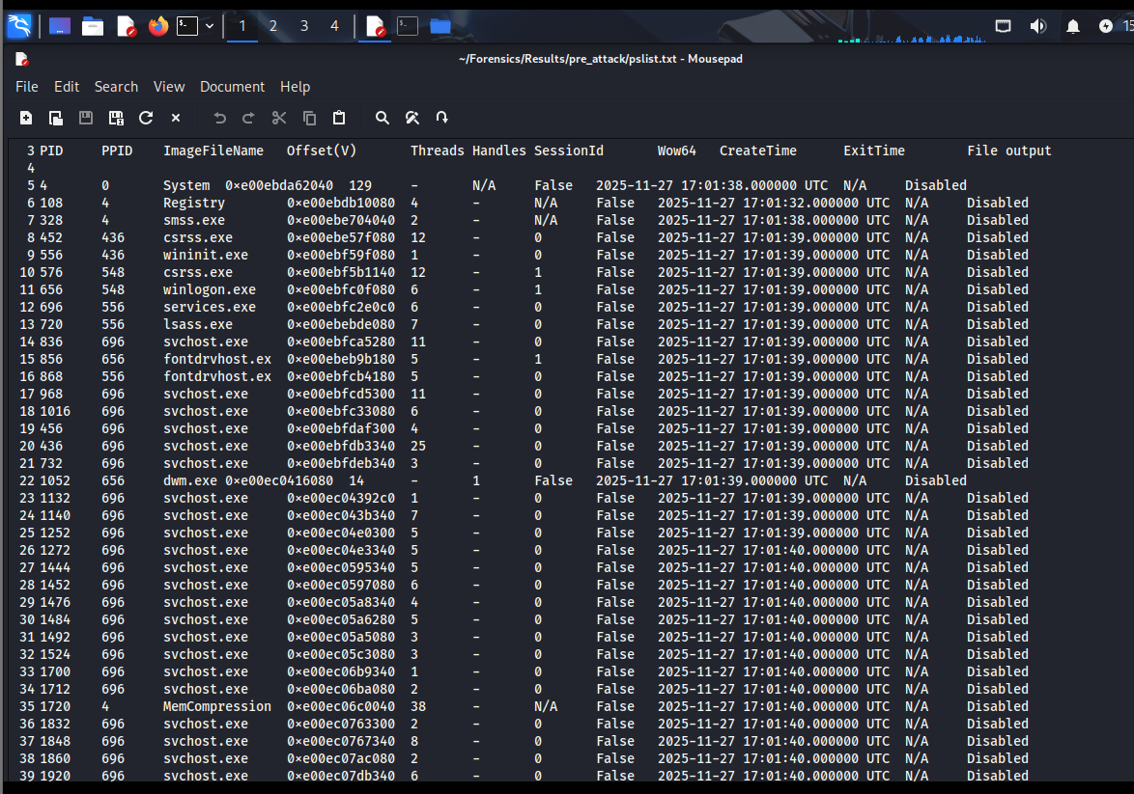
Pre-Attack Baseline — Normal Process Listing
Process list shows only legitimate system and user activity.
No unknown binaries, no injected threads, and no suspicious parent-child relationships.
Establishes what “clean” looks like before malicious activity begins.
Critical for later comparison to identify anomalies introduced during the attack.

Slide 5
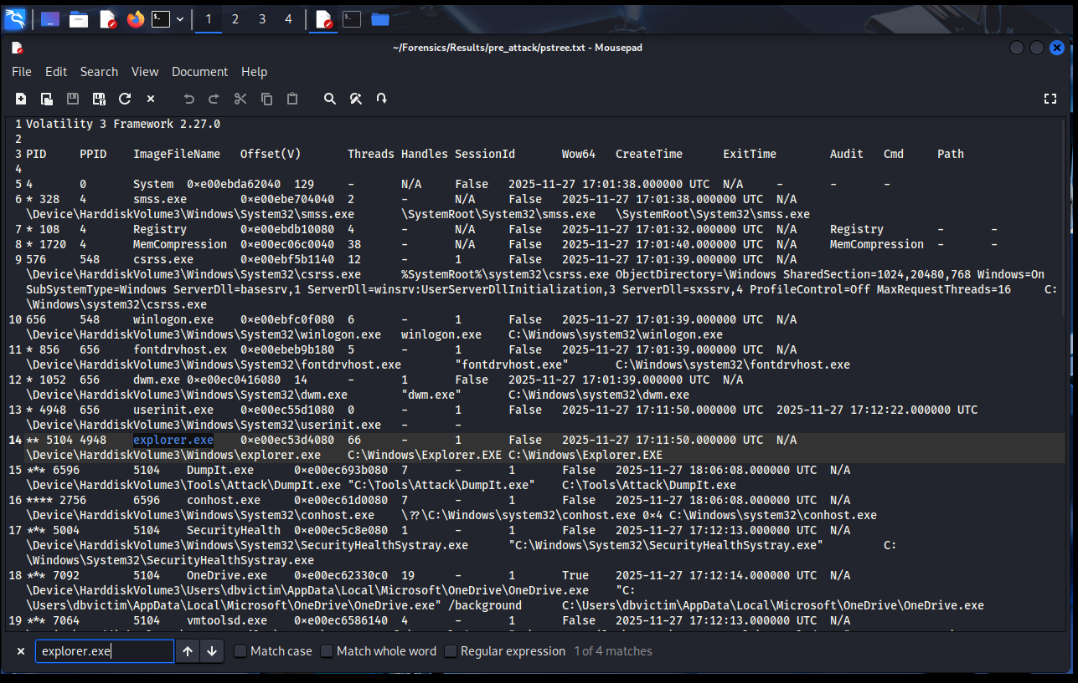
Pre-Attack — Expected Parent/Child Process Hierarchy
Process tree visualization confirms standard Windows process lineage.
explorer.exe → cmd.exe → conhost.exe relationships reflect routine user operations.
No memory acquisition tools, credential harvesting tools, or suspicious command paths detected.

Slide 6
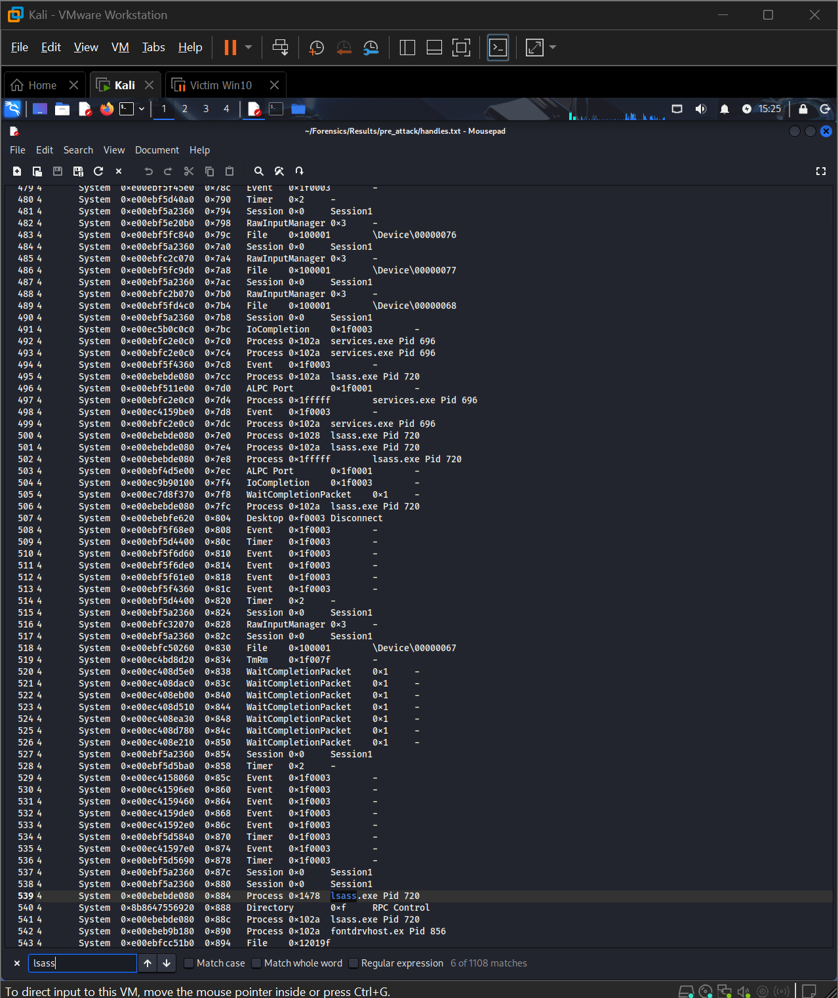
Pre-Attack — Clean DLL & Handle Profiles
explorer.exe loads only Windows-signed DLLs from System32.
lsass.exe shows normal handle profile without cross-process memory access attempts.
This baseline helps identify abnormal loading patterns in later dumps.

Slide 7
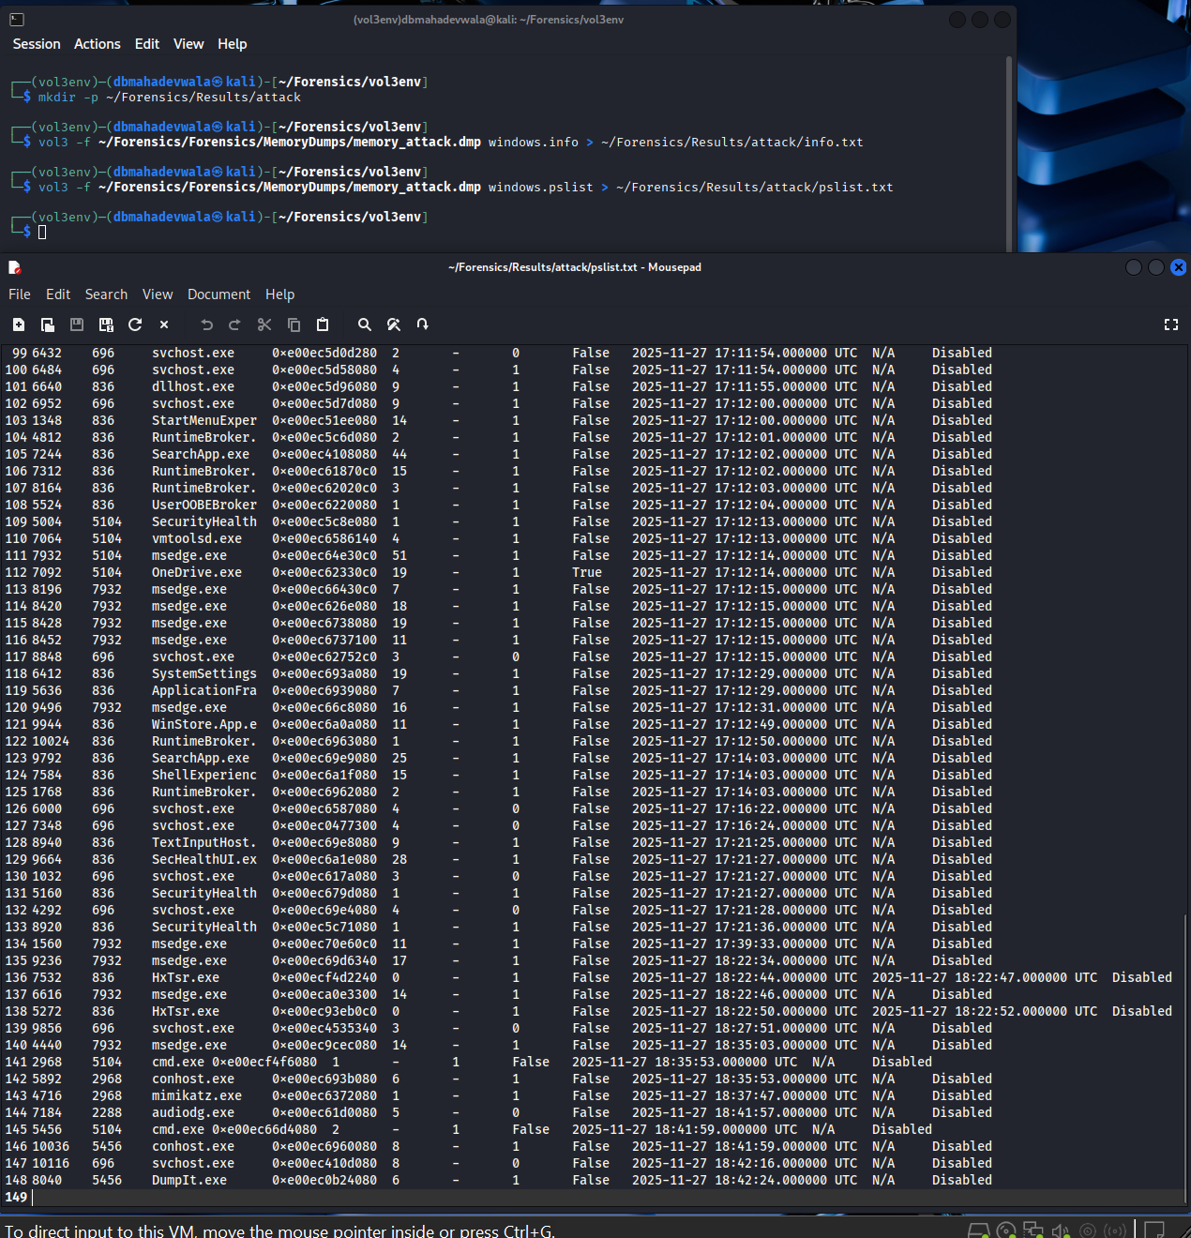
During Attack — Malicious Processes Observed
Process list reveals DumpIt.exe and mimikatz.exe, two definitive indicators of compromise.
conhost.exe processes spawn under attacker-controlled cmd.exe sessions.
DumpIt is used to extract memory; Mimikatz attempts credential harvesting.
Their simultaneous presence strongly indicates an active credential theft operation.

Slide 8
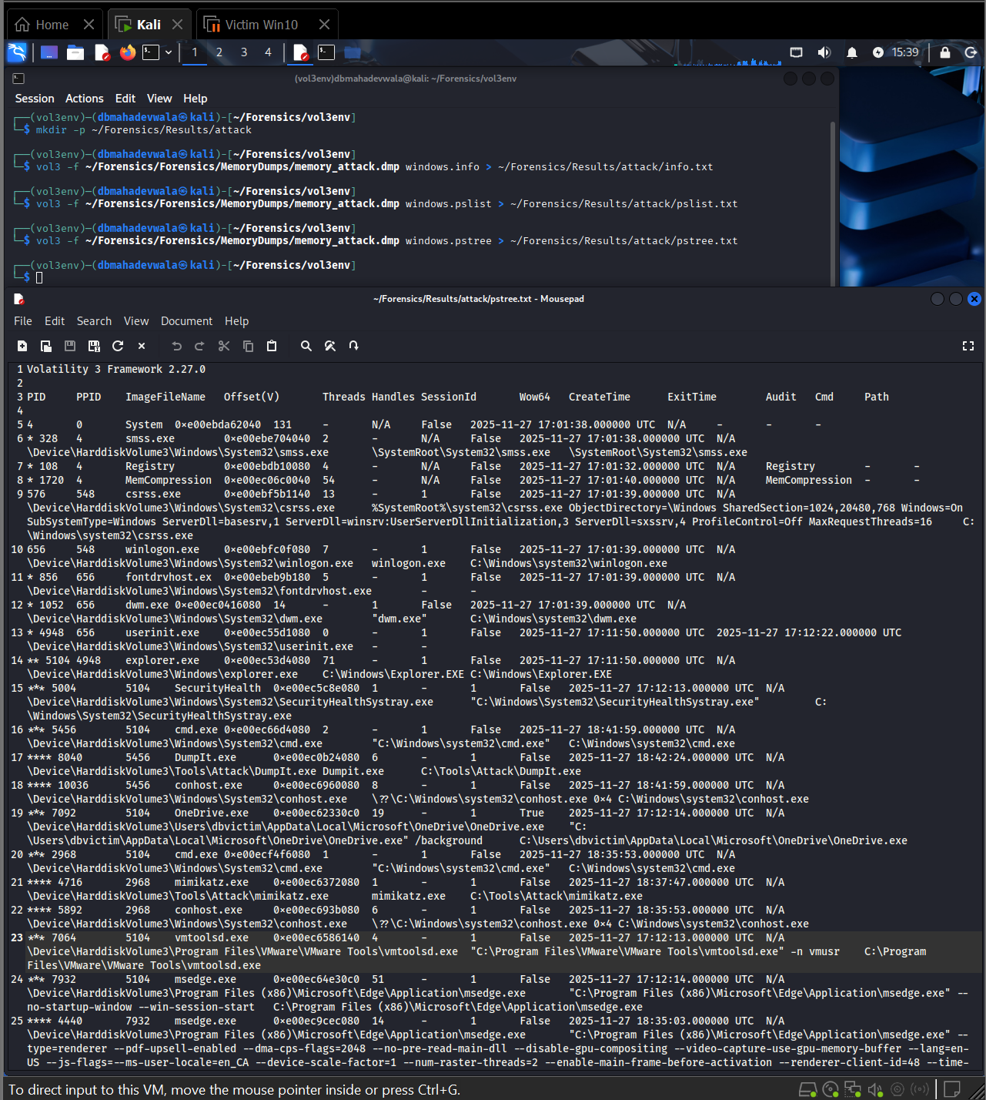
During Attack — Process Tree Showing Attack Chain
pstree confirms a predictable intrusion path: explorer.exe → cmd.exe → conhost.exe → DumpIt.exe / mimikatz.exe
Demonstrates attacker privilege level and execution method (interactive session).
Highlights that the attacker executed tools manually rather than via automation or malware.

Slide 9
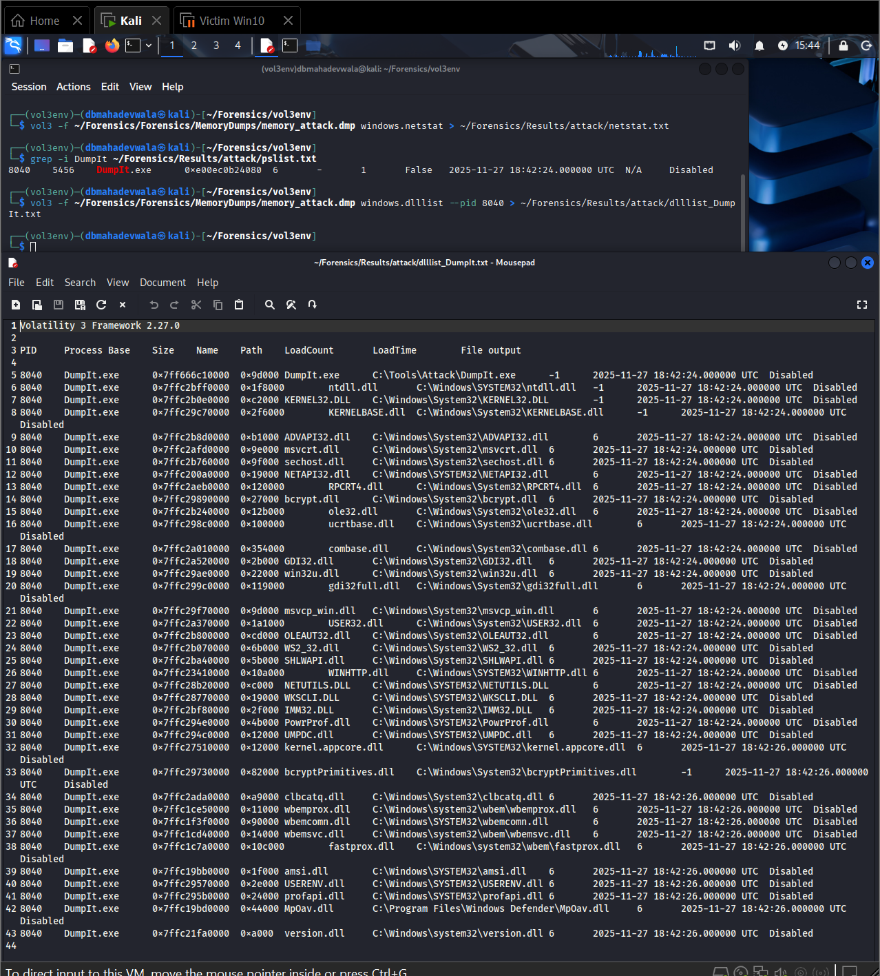
During Attack — DLL Indicators of Credential Theft
dlllist shows DumpIt.exe and conhost.exe loading custom DLLs not associated with standard Windows operations.
Mimikatz-related modules appear in memory, confirming execution even if the binary were deleted.
DLL forensics are essential because many attackers attempt to hide or remove executables afterward.

Slide 10
During Attack — LSASS Memory Access Identified
Handles show mimikatz.exe accessing lsass.exe, the credential vault of Windows.
lsass handle access is one of the strongest indicators of credential dumping.
Kernel-level objects (\Device\KsecDD) accessed during DumpIt.exe execution confirm system-level memory manipulation.

Slide 11
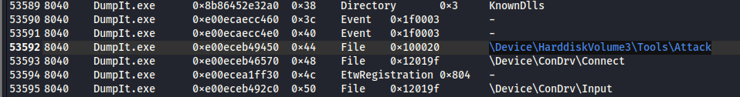
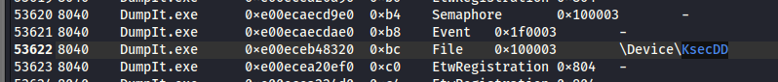
During Attack — Kernel Memory & Disk Volume Interaction
DumpIt.exe is observed interacting with \Device\KsecDD, confirming raw kernel memory access.
Handles to physical volumes & OS directories show full system enumeration.
This creates a forensic trail proving the attacker dumped memory at scale, not just specific processes.

Slide 12
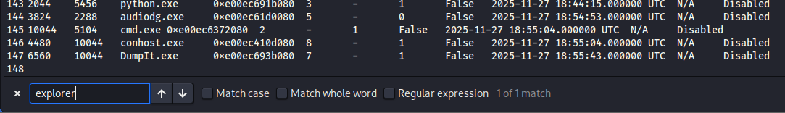
Post-Attack — Mimikatz Absent, But DumpIt Persists
pslist no longer shows mimikatz.exe, indicating attacker closed the tool.
However, DumpIt.exe remains active, demonstrating incomplete cleanup and lingering compromise.
Processes like conhost.exe still show traces of being used as staging components for the attack.

Slide 13
Post-Attack — Explorer.exe Still Linked to Attack Artifacts
Even after tool deletion, explorer.exe retains open file/registry handles referencing the attacker’s staging directories.
Post-attack memory still contains traces of executed Mimikatz files.

Slide 14
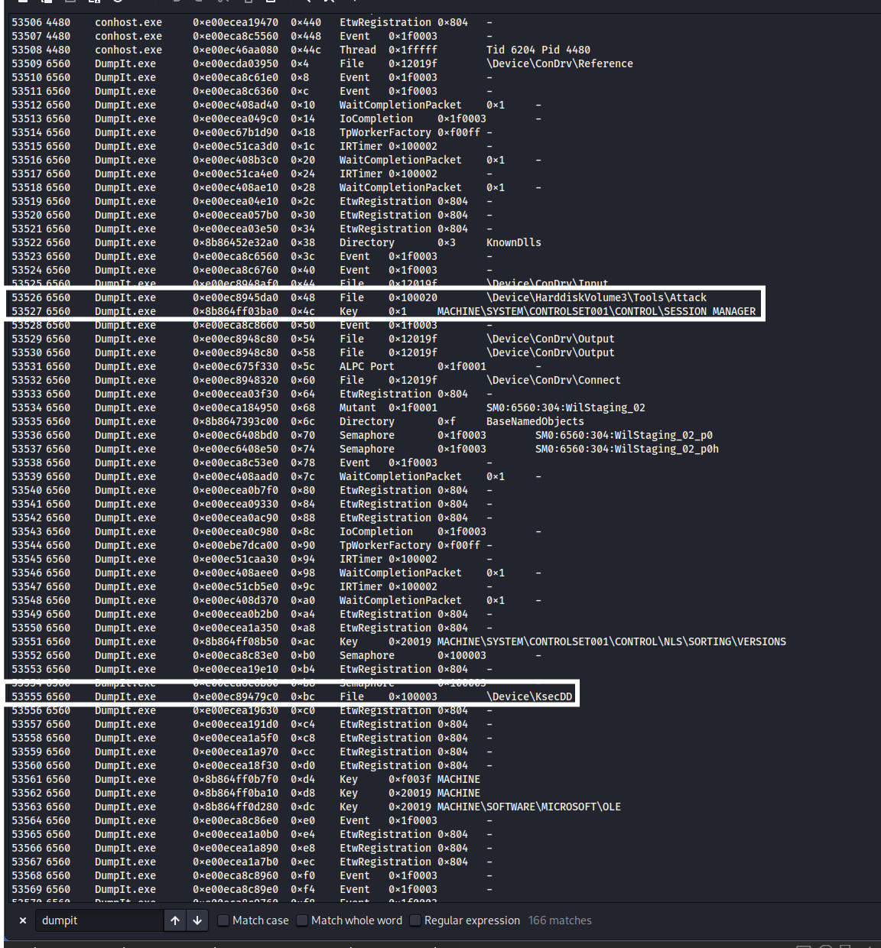
Post-Attack — DumpIt’s Kernel Handles Still Active
DumpIt.exe continues to hold open handles to KsecDD, confirming persistent kernel-level access.
These remnants prove that sensitive memory regions remain exposed even after the attacker exits.
Reinforces that “closing the tool” does not reverse the compromise.

Slide 15
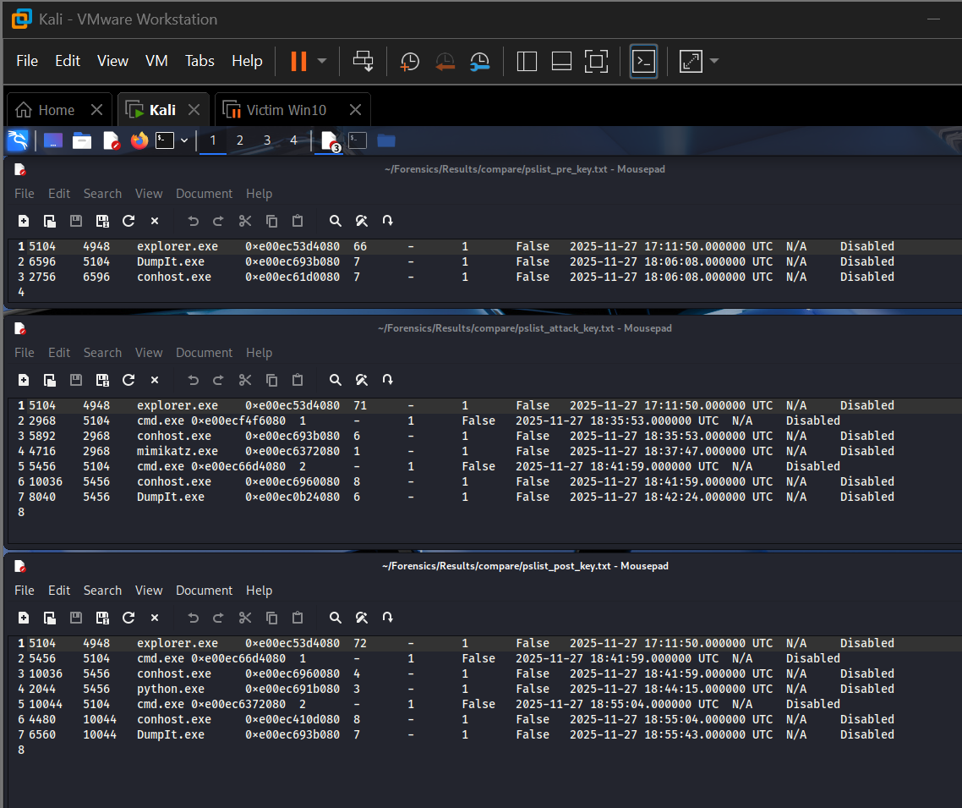
Process | Pre-attack dump | During-attack dump | Post-attack dump
explorer.exe | Present, parent userinit, no link to attack tools | Present; parent of cmd.exe that launches tools | Present; still holds handles to Mimikatz directory
cmd.exe | Not present or only short-lived baseline activity | Present as child of explorer.exe; parent of conhost.exe and attacker tools | May still be present with conhost.exe and DumpIt chain
conhost.exe | Only generic console hosts (if any) | Specific instance associated with cmd.exe, child for DumpIt.exe / mimikatz.exe | Associated with cmd.exe / DumpIt.exe, but no active mimikatz.exe child
DumpIt.exe | Absent | Present; child of cmd.exe; holds KsecDD and disk handles | Present or recently exited; still has kernel-level and tool directory handles
mimikatz.exe | Absent | Present; child of cmd.exe / conhost.exe; opens LSASS handles | No longer listed as a running process, but handles and explorer references remain
lsass.exe | Present with normal handles and DLLs | Present; targeted by mimikatz.exe handles and possibly by DumpIt via full memory access | Present; shows no crash but continues normal activity after being accessed

Slide 16

Lessons Learned & Reflection
Memory forensics provides unparalleled visibility into both active and residual attacker activity.
Tools like Mimikatz leave behind detectable forensic artifacts even after deletion.
Attackers often fail to fully remove their footprint, making post-attack snapshots invaluable.
Reinforced importance of:
Kernel-level monitoring
LSASS protection
Restricting interactive logins
Ensuring memory acquisition integrity
This project strengthened skills in incident reconstruction, malware behavior analysis, and DFIR methodologies.

Slide 17
Final Summary of Findings
Pre-Attack: system normal and uncompromised.
During Attack: full credential theft operations captured in memory.
Post-Attack: attacker attempted cleanup, but volatile artifacts prove continued compromise.
Volatility 3 successfully reconstructed the entire kill chain from memory alone.
Demonstrates the critical role of memory forensics in modern cybersecurity investigations.

